Slide 1
Generative Adversarial Networks (GANs)
Clara BOMY – Henri HOYEZ – Nicolas THUYLIE

Slide 2
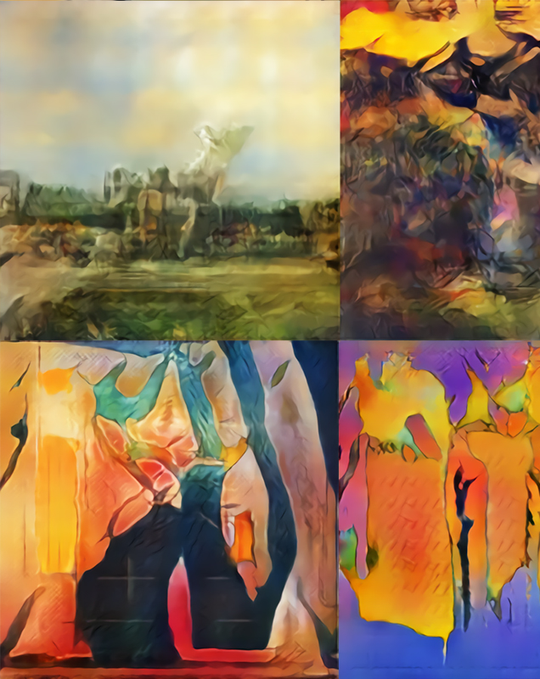
Overview

Slide 3
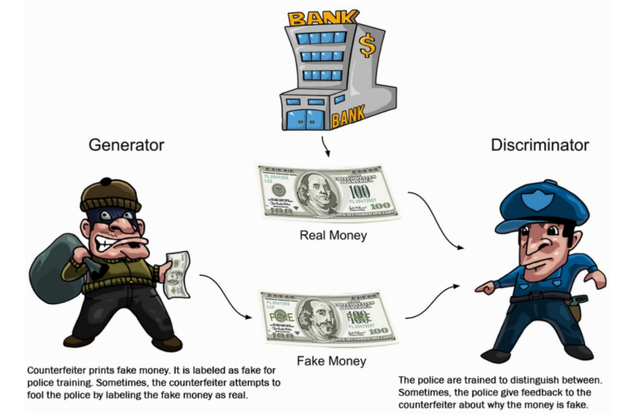
Two “adversarial” models
A GAN is composed of two parts : the generator network and the discriminator network.
Generator : its role is to create data in such a way that it can fool the discriminator.
Discriminator : its role is to distinguish between actual and generated (fake) data.

Slide 4


Slide 5
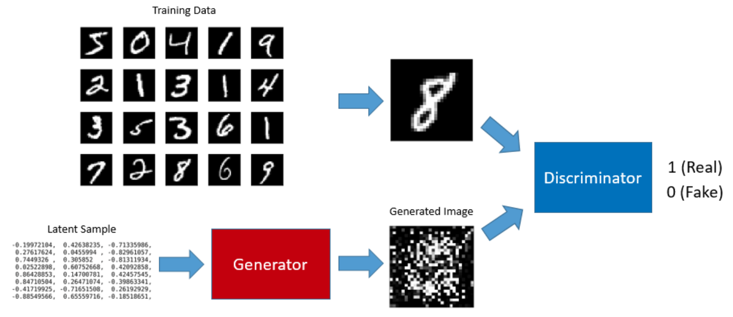

Slide 6
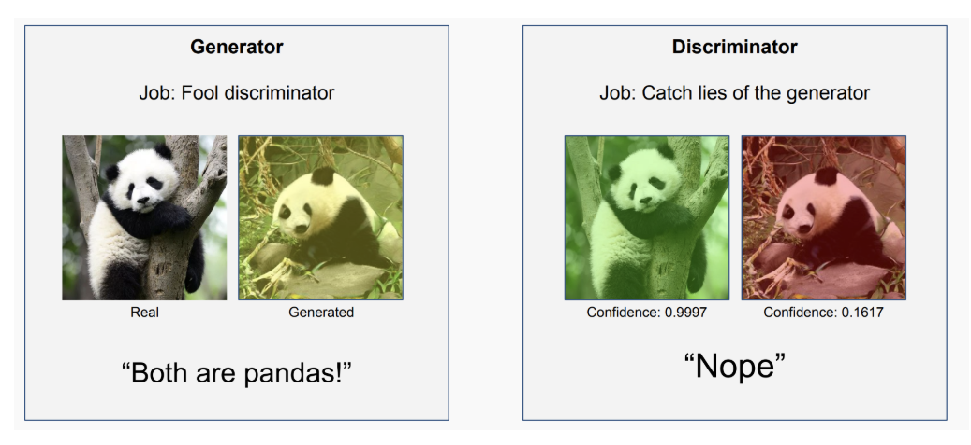
Example
The generator creates “fake” pieces of data, in this case, images of pandas, to try and fool the discriminator into classifying the image as a real panda.

Slide 7
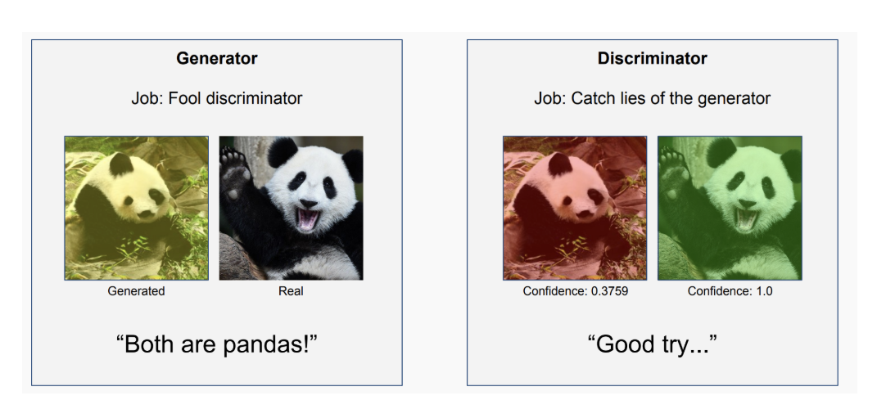
Initially, the images may be fairly obviously faked, but as the networks get better, it becomes harder to distinguish between real and fake images, even for humans!

Slide 8
Network representation

Slide 9
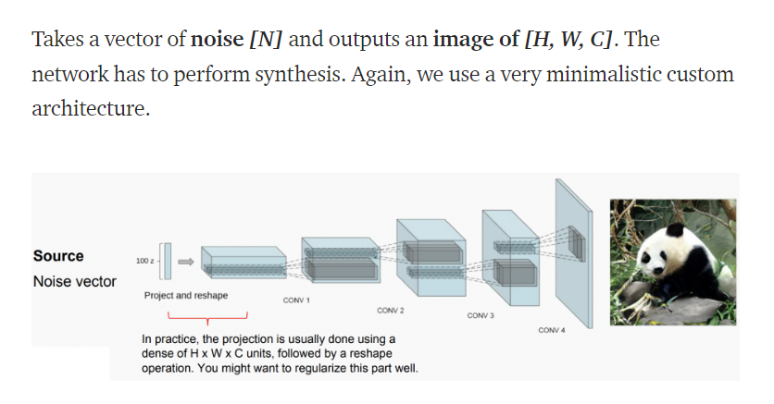
The generator
G(z) gives the same shape of the real input

Slide 10
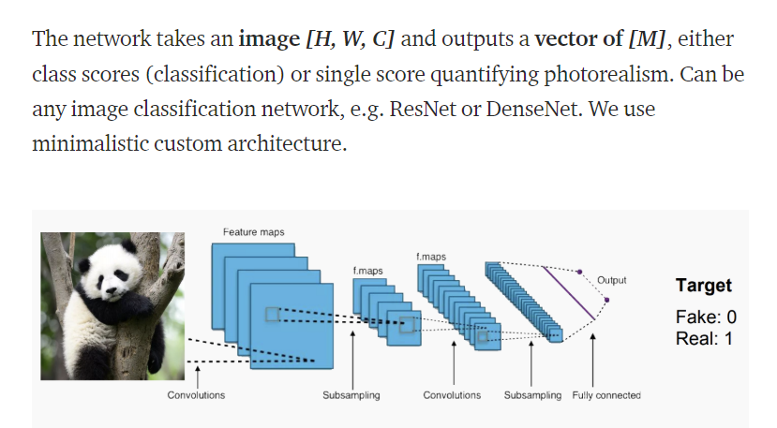
The discriminator
D(x), D(G(z)) give a score between 0 and 1

Slide 11
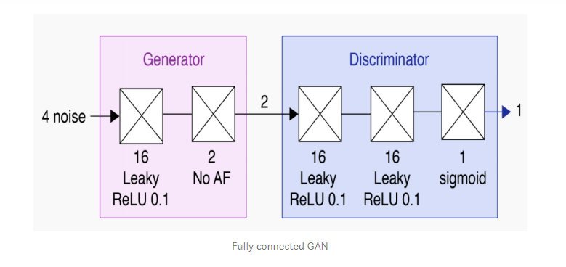
Two main types
Fully connected GANs (FC-GANs) : more appropriate for single data points
Deep Convolutionnal GANs (DC-GANs) : more appropriate for images

Slide 12
Network training

Slide 13
During the training, the generator G gets stronger and stronger at generating the real type of results and the discriminator D also gets stronger and stronger at identifying which one is real, which one is fake.
Repeat this process for certain no of epochs :
Take some noise from random distribution and feed it to the Generator G to produce the fake data
Take the fake data and the real data and feed it to the Discriminator D alternatively
Calculate D loss
Back propagation – update weights of discriminator
Calculate G loss
Back propagation – update weights of generator

Slide 14
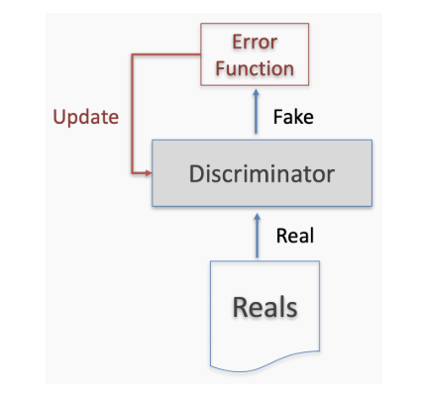
False negative
Input : real data
Discriminator : predicts fake data
Generator not involved
Error function here only involves the discriminator -> backpropagation step through the discriminator, updating its weights so that it will get better at recognizing reals.

Slide 15
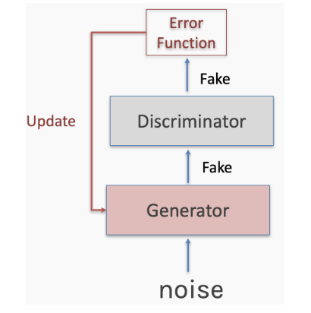
True negative
Input : fake data
Discriminator predicts fake data
The generator got caught !
Backpropagation goes through the discriminator (which is frozen) to the generator.
The generator is updated, so it can better learn how to fool the discriminator.

Slide 16
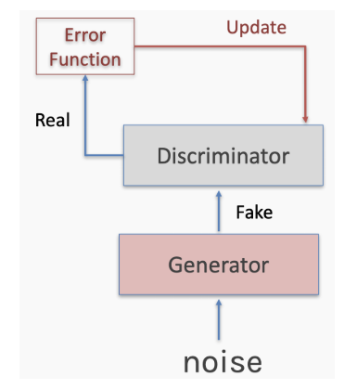
False positive
Input : fake data
Discriminator : predicts real data
Backpropagation step through the discriminator, updating its weights so that it will get better at recognizing fakes.

Slide 17
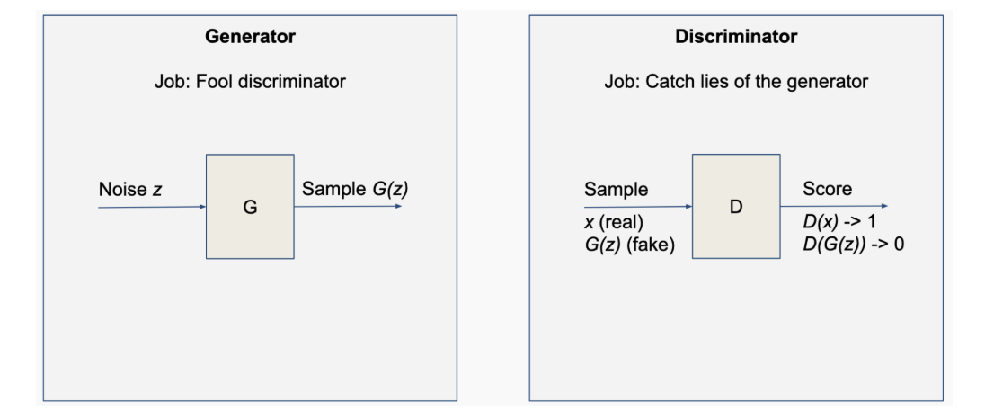
z : noise
G(z) : output of the generator (= fake data)
D(x) : prediction from the discriminator on a real data
D(G(z)) : prediction from the discriminator on our fake data

Slide 18
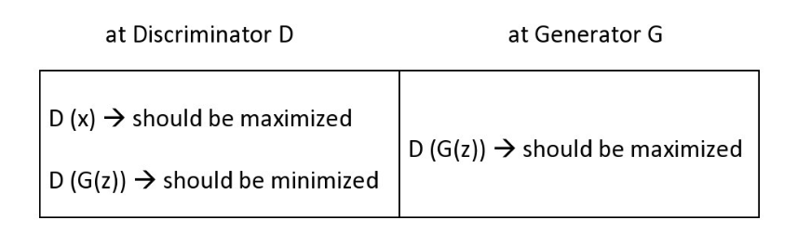
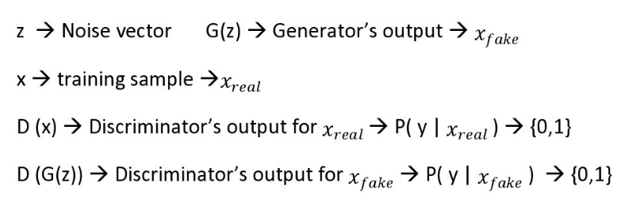
Add mathematical equations…

Slide 19
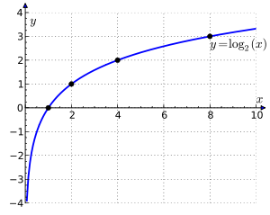
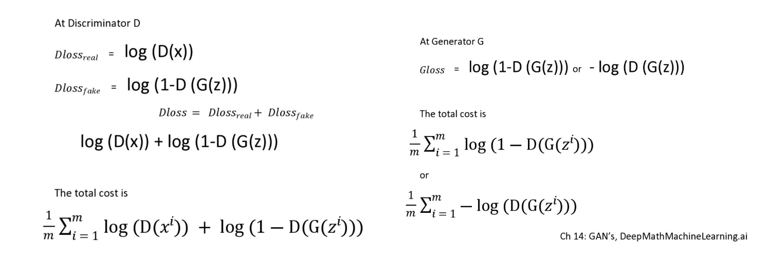

Slide 21
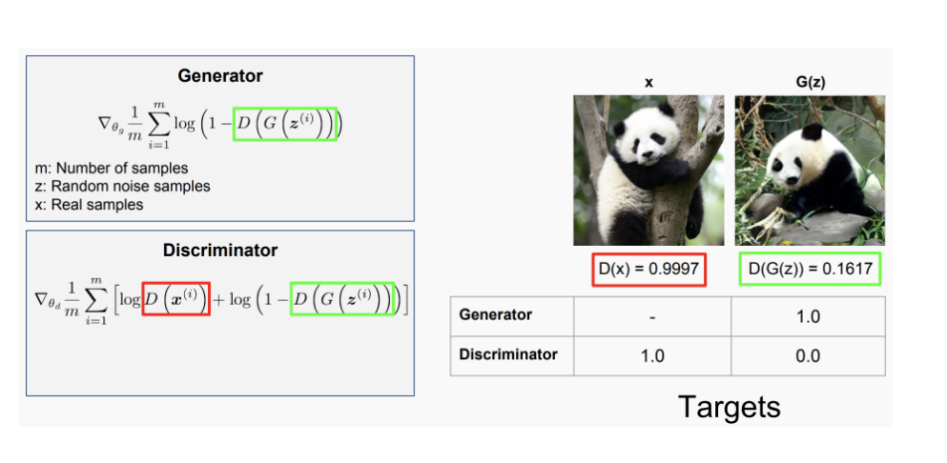
With the example

Slide 22
Problems with GANs

Slide 23
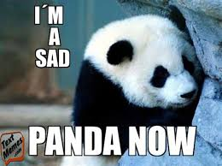
Training a GAN is very difficult and time-consuming.
The training of a GAN may take few hours on a GPU and few days on a CPU for small models.

Slide 24
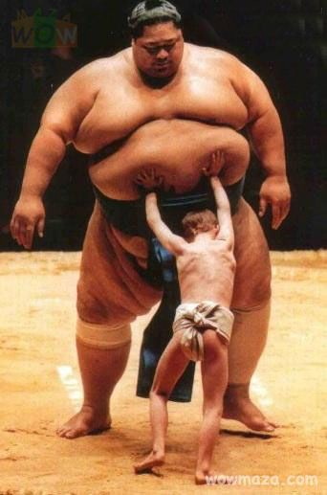
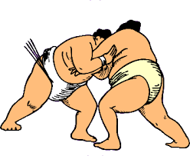
Oscillations
Training is a cooperative game where two players push each other as hard as possible. No theoretical guarantee of convergence and in fact, the outcome can oscillate.
Generator and discriminator are jointly searching for equilibrium, but the model updates are independent.
That we want (at the end…)

Slide 25
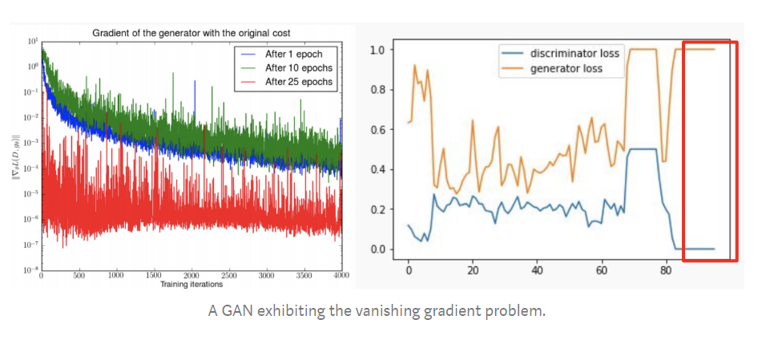
Vanishing gradient
If the generator gets too good too fast (it rarely occurs the other way around), the generator can learn to fool the discriminator consistently and will stop needing to learn anything.

Slide 26
If the Discriminator gets stronger quickly :
D(x) = 1, D(G(z)) = 0
at generator G → log(1 — D(G(z))) = log(1–0) = 0
then the gradient of the loss function is 0 and the learning is stopped.
If the Discriminator gets too weekly, then the generator does not have good feed back and the loss represent nothing much.

Slide 27
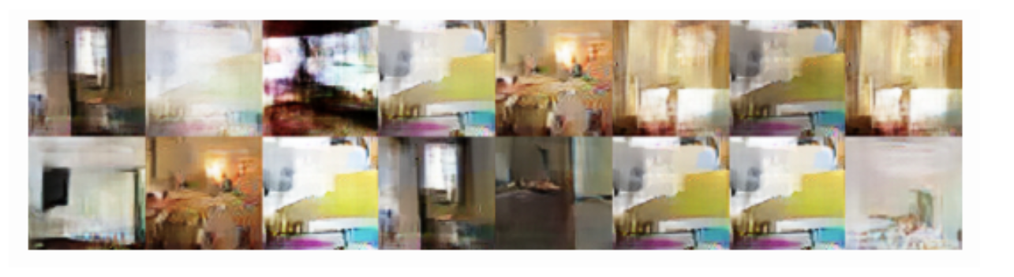
Model collapse
Happened when all the generator outputs are identical
It gets stuck at a point with producing limited varieties of samples or one sample repeatedly during or after training the GAN.

Slide 28
No proper evaluation metrics
We don’t really know when to stop the training => no proper evaluation metric in training GAN’s
Visual inspection is required
The losses don’t really tell much in GAN’s unlike other deep learning algorithms. Due to this, often we end up not having a good GAN model.

Slide 29
GAN Use Cases

Slide 30
Text to Image Generation
We give a small text as input of the GAN and it generates images which look like a real image. It is used to increase datasets sizes or simply for the art.

Slide 31
Image to Image Translation
We gave an image in entry and the GAN return a different appearance of the image. It can be used to generate quickly a virtual environment or to colorize images.
http://nvidia-research-mingyuliu.com/gaugan/

Slide 32
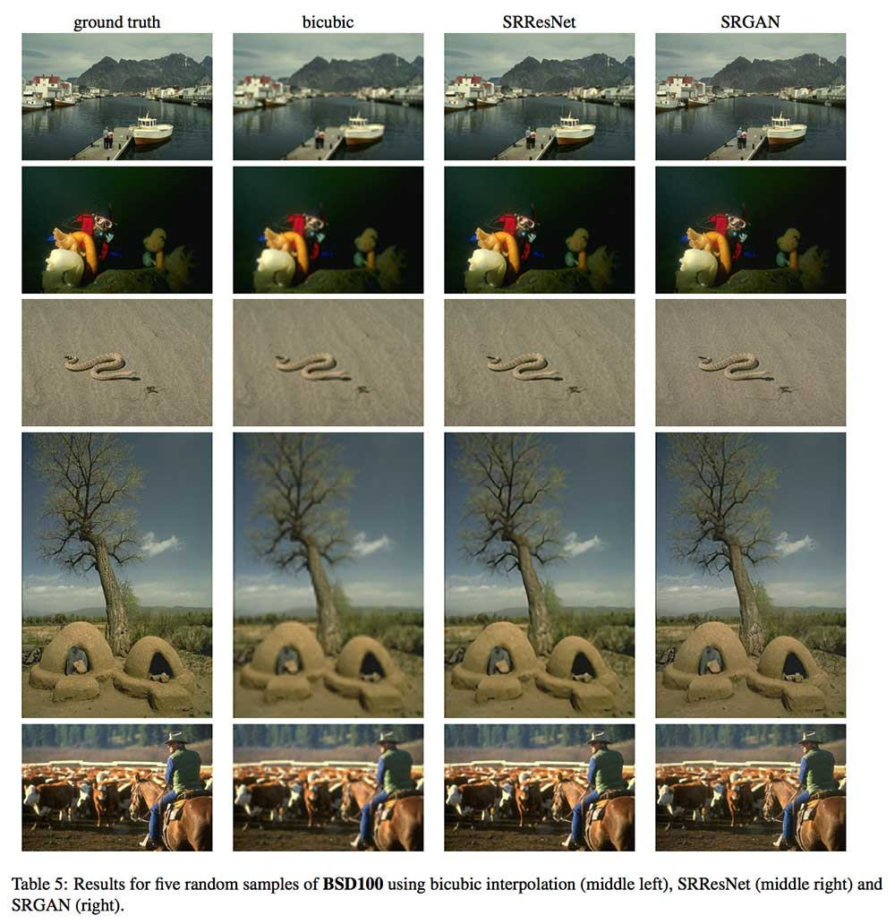
Increasing Image Resolution
GAN can improve sorely the quality of an image.

Slide 33
Predicting Next Video Frame
Predict next video frame can be useful for quickly restore a film.

Slide 34
